Slide 1
Mushroom dataset
Computational Intelligence and Decision Making - Mattia Fucili

Slide 2
Introduction
The dataset contains 23 species of gilled mushrooms
Each mushroom is labelled as edible or poisonous
The goal is to classify them in edible or poisonous

Slide 3
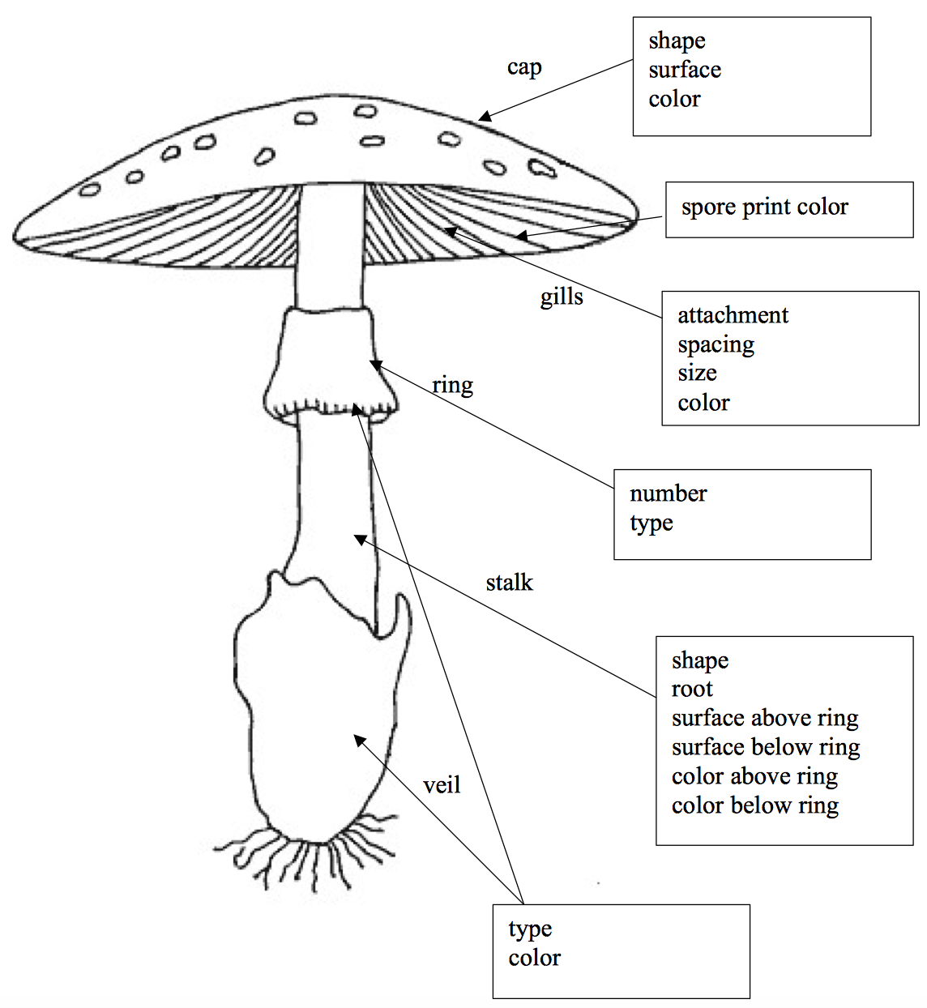
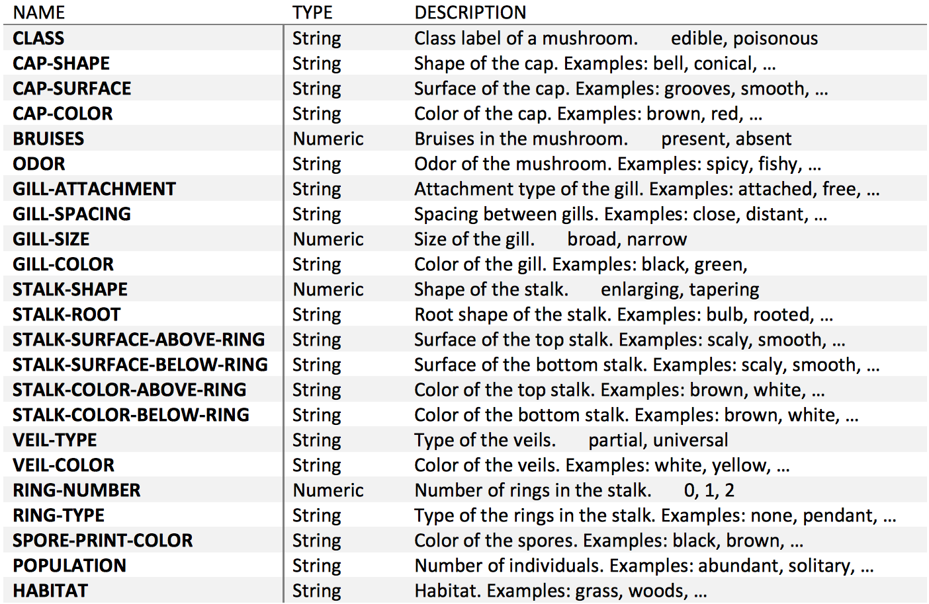
Features explanation

Slide 4
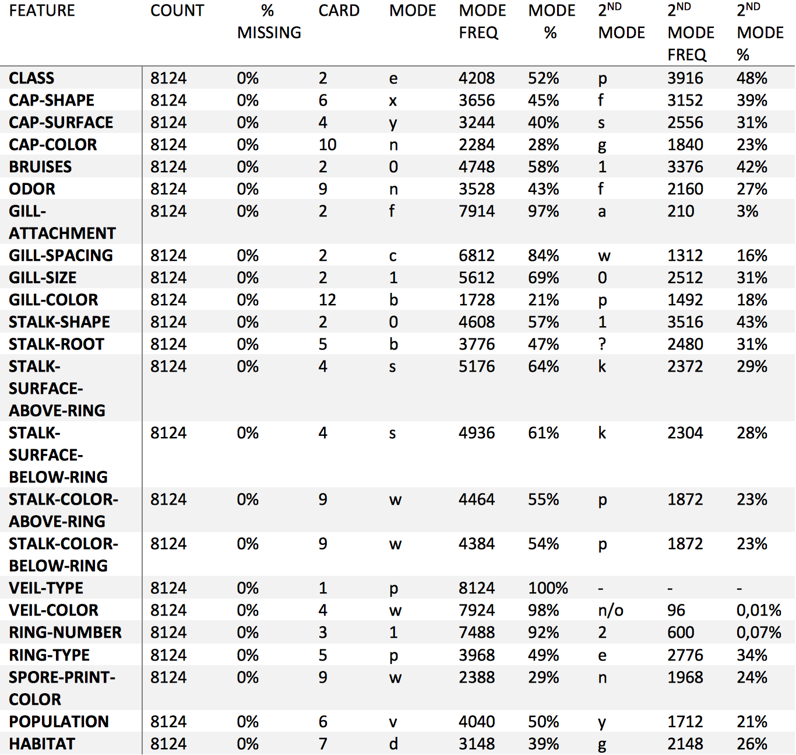
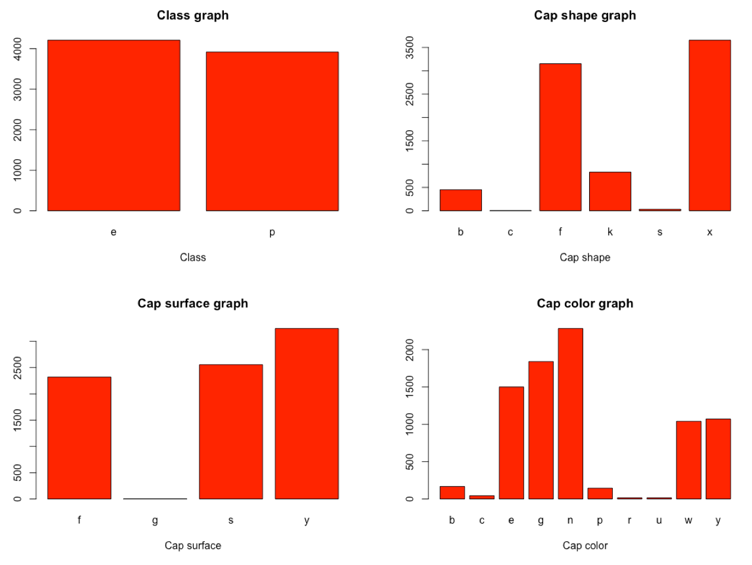
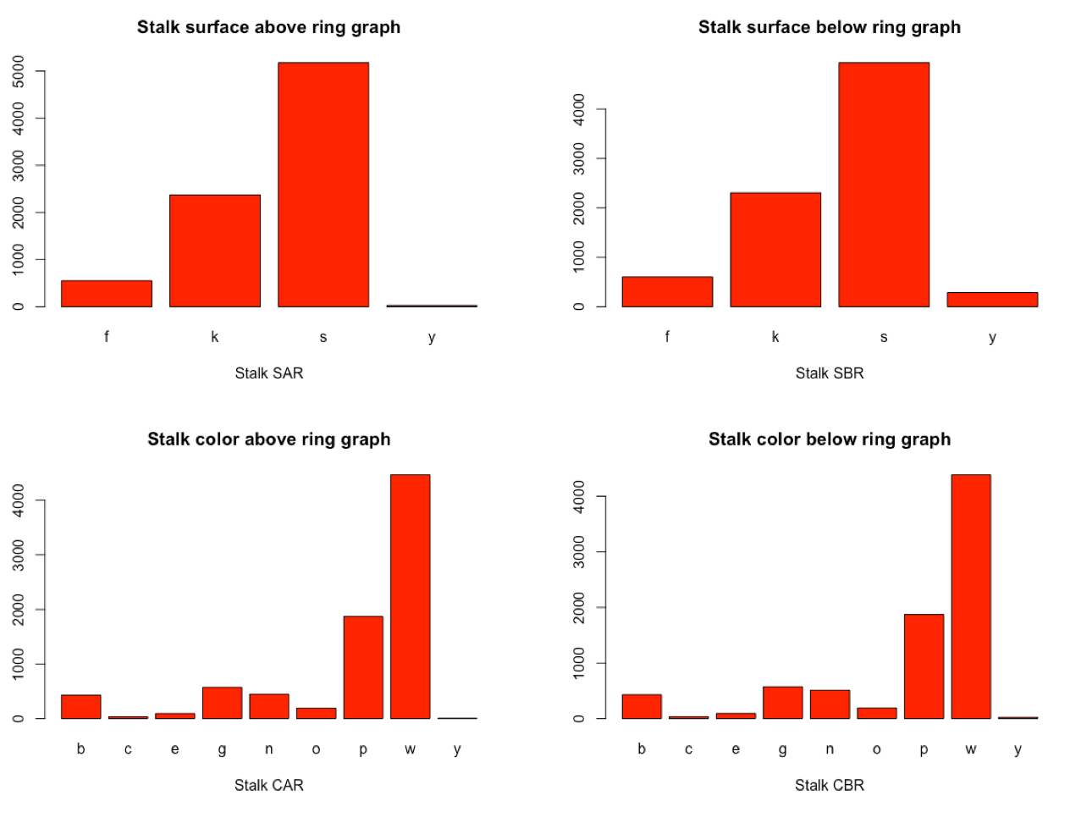
Data Analysis

Slide 5
Data Analysis
veil-type removed
No merge
No outliers
No correlation
Information Gain
  odor – 0,63
  spore-print-color – 0,33
  gill-color – 0,29
  ring-type – 0,22
  stalk-surface-above-ring – 0,20

Slide 6
Test & train
Train – 80%
Test – 20%

Slide 7
Decision tree – CART
Python – sklearn
All numerical features
Accuracy between 99,8% - 100%
AUC between 0,998 – 1.000
Confusion matrix

Slide 8
SVM
Python – sklearn
All numerical features
Accuracy between 99,4% - 99,9%
AUC between 0,994 – 0,998
Confusion matrix

Slide 9
Comparison
Other people worked on it and here are some results
  Logistic regression – AUC: 0,99
  Bayes – AUC: 0,96
  SVM – AUC: 1,00
  Random forest – AUC: 1,00
  CART – AUC: 1,00
  NN – AUC: 1,00

Slide 10
Conclusion
Both approaches perform well, but CART slightly better
Delicate task, so I would suggest CART

